Slide 1
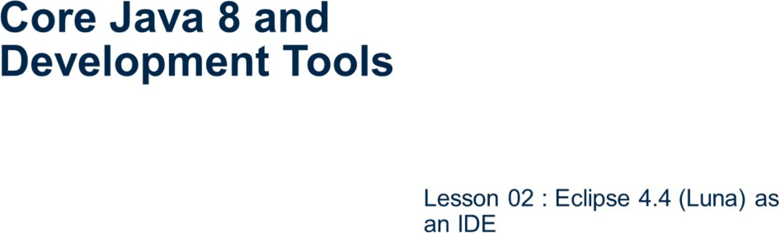
Core Java 8 and Development Tools
Eclipse 4.4 as an IDE
Page 02-1

Slide 2
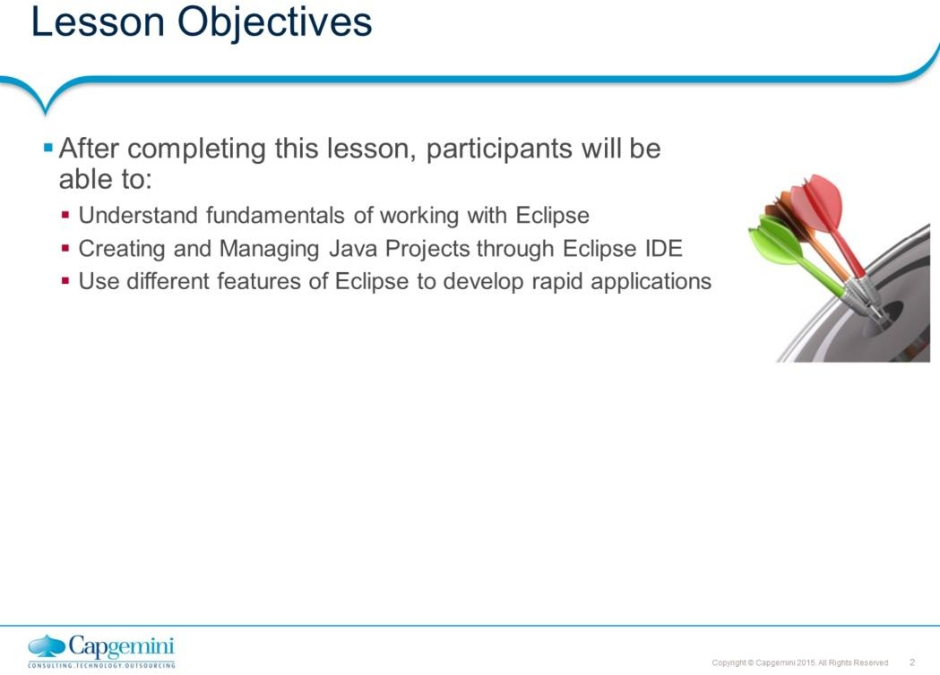
Core Java 8 and Development Tools
Eclipse 4.4 as an IDE
This lesson demonstrate the use of IDE to create Java applications with ease.
Lesson Outline:
Lesson 2: Eclipse4.4 as an IDE
2.1: Installation and setting up Eclipse 2.2: Introduction to Eclipse IDE
: To create and manage Java projects
: Debugging your Java Program 2.4: Miscellaneous options
: Creating Jar files
: Verifying JRE installation 2.4.3: Creating a Jar file
: Setting Classpath
: Passing Command line arguments 2.4.6: Import and Export Options
: Automatic Build/Manual Build options
: Using Javadocs 2.4.9: Tips and Tricks
Page 02-2

Slide 3
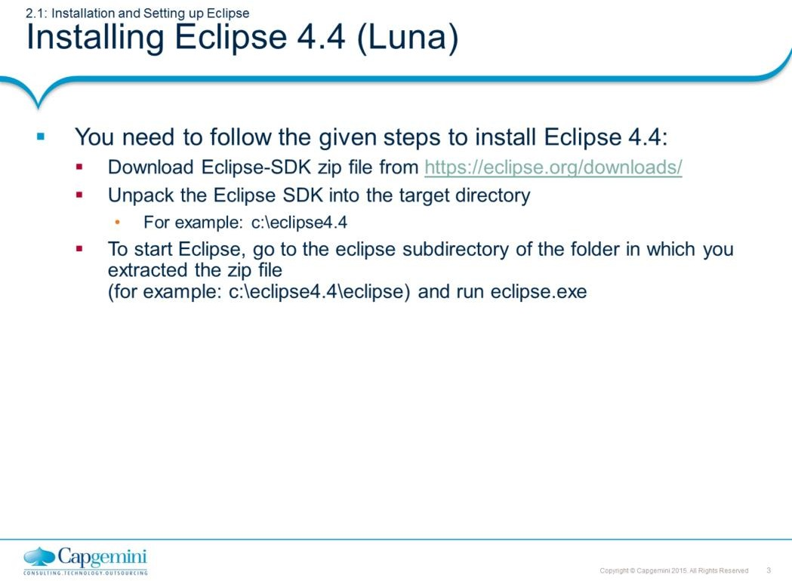
Core Java 8 and Development Tools
Eclipse 4.4 as an IDE
Page 02-3

Slide 4
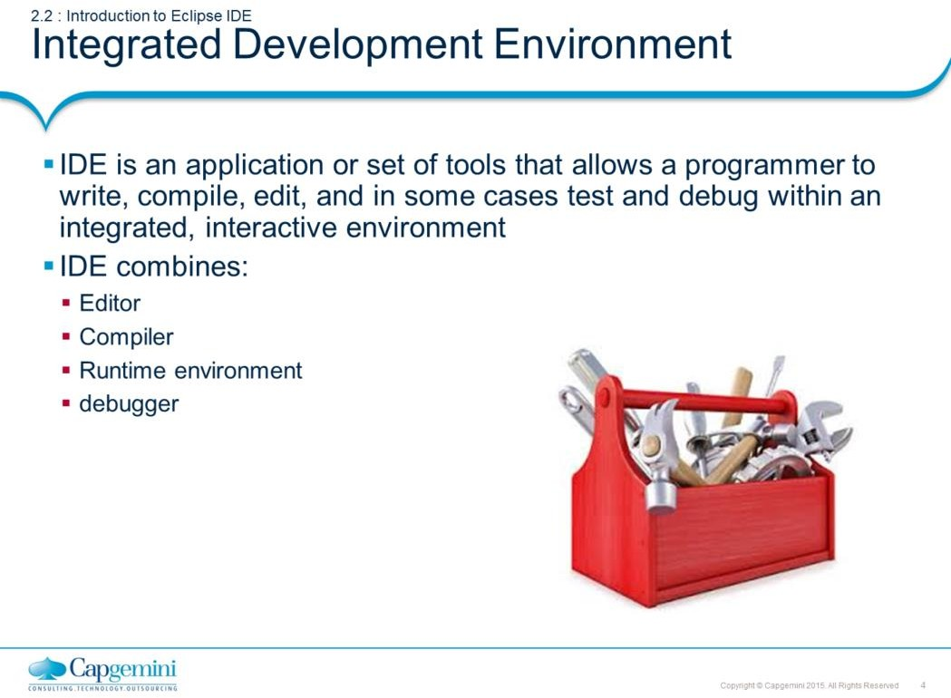
Core Java 8 and Development Tools
Eclipse 4.4 as an IDE
What is an IDE?
The Eclipse Project is an open source software development project dedicated to providing a robust, full-featured, commercial-quality, industry platform for the development of highly integrated tools and rich client applications. Eclipse runs on Windows, Linux, Mac OSX, Solaris, AIX and HP- UX. Eclipse is actually a generic application platform with a sophisticated plug in architecture - the Java IDE is just one set of plugins. There is an active community of third party Eclipse plugin developers, both open source and commercial. Our objective is to code Java programs faster with Eclipse 4.4 as an IDE.
Eclipse4.4 features include the following:
Creation and maintenance of the Java project
Developing Packages
Debugging a java program with variety of tools available
Running a Java program
Developing the Java program will be easier as Eclipse editor provides the
following:
Syntax highlighting
Content/code assist
Code formatting
Import assistance
Quick fix
Page 02-4

Slide 5
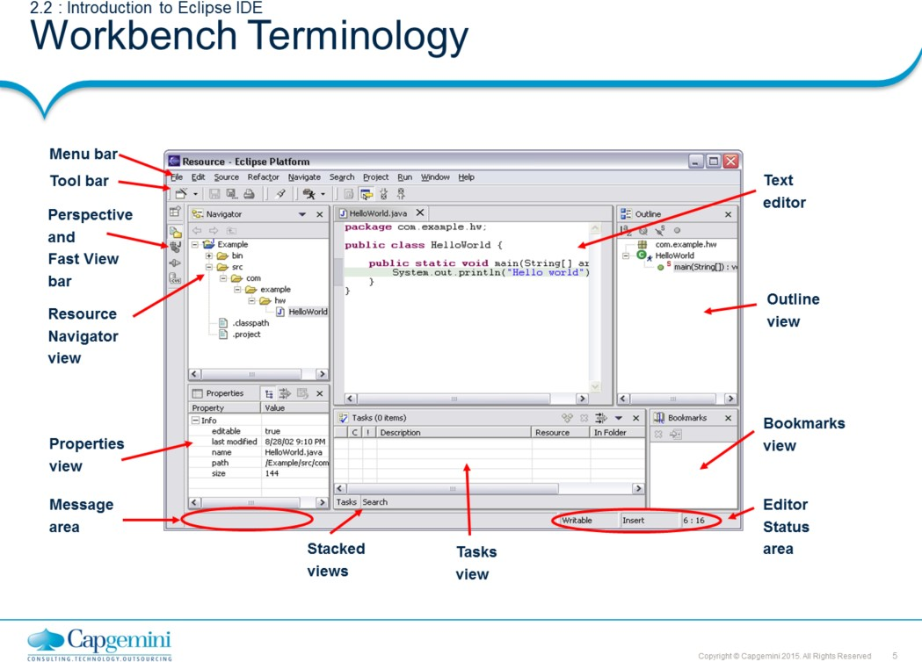
Core Java 8 and Development Tools
Eclipse 4.4 as an IDE
Page 02-5

Slide 6
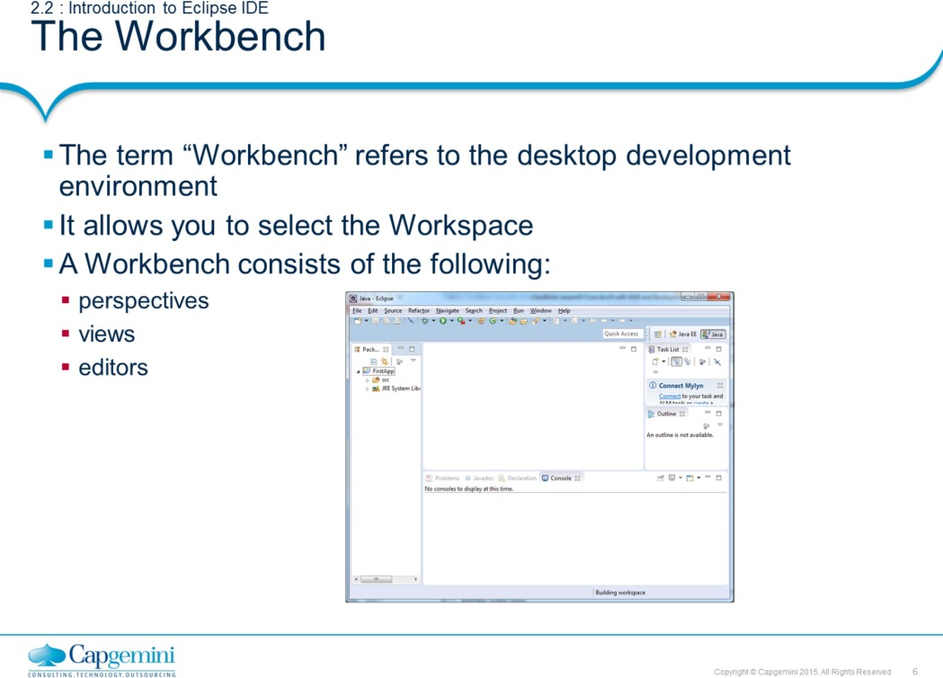
Core Java 8 and Development Tools
Eclipse 4.4 as an IDE
Page 02-6

Slide 7
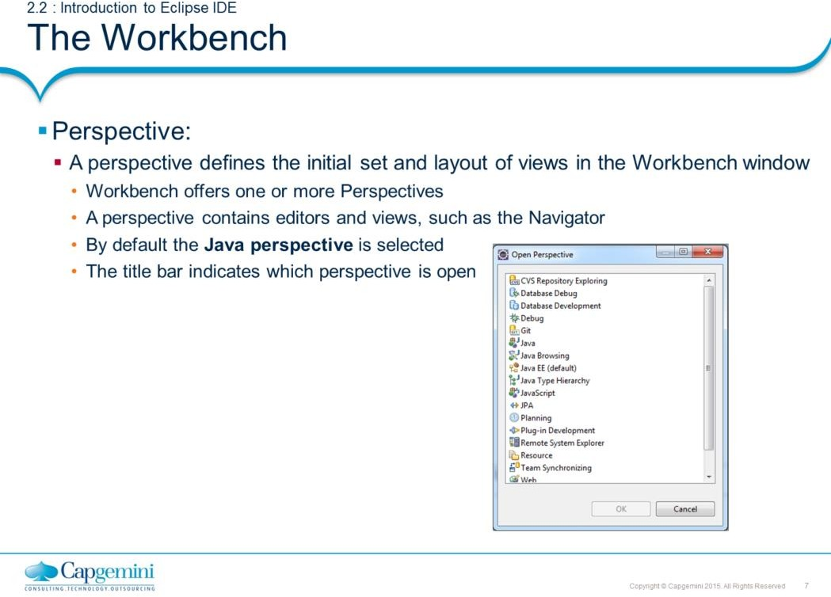
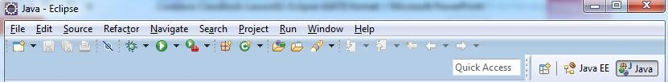
Core Java 8 and Development Tools
Eclipse 4.4 as an IDE
The Workbench:
The term Workbench refers to the desktop development environment.
Perspectives:
Each Workbench window contains one or more perspectives. Perspectives contain views and editors and control what appears in certain menus and tool bars. They define visible action sets, which you can change to customize a perspective. You can save a perspective that you build in this manner, making your own custom perspective that you can open again later. By default the Java perspective is selected.
Each perspective provides a set of functionality aimed at accomplishing a specific
type of task or works with specific types of resources.
For example: The Java perspective combines views that you would commonly use while editing Java source files, while the Debug perspective contains the views that you would use while debugging Java programs. As you work in the Workbench, you will probably switch perspectives frequently.
Page 02-7

Slide 8
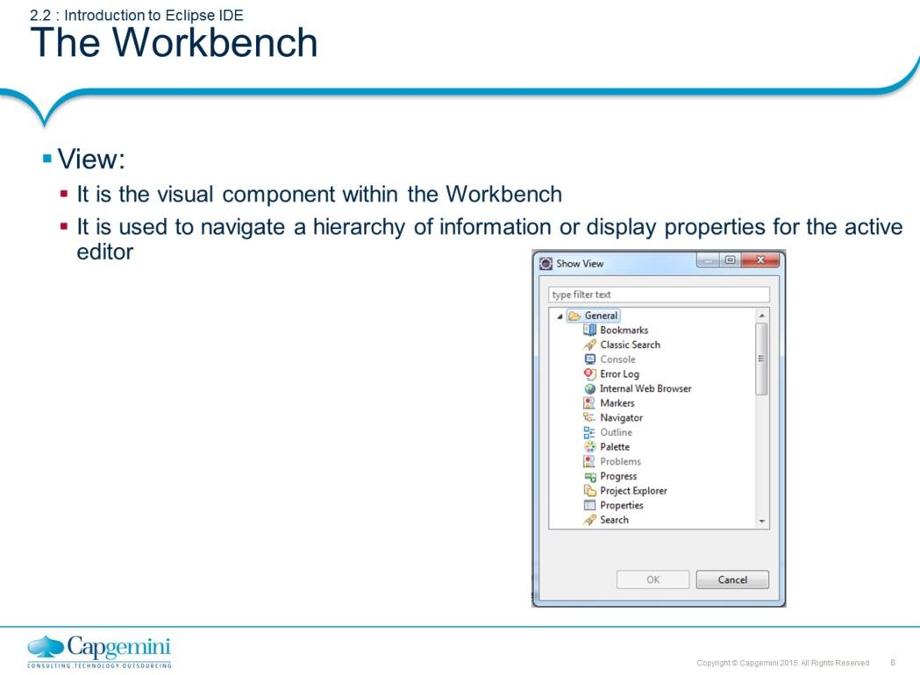
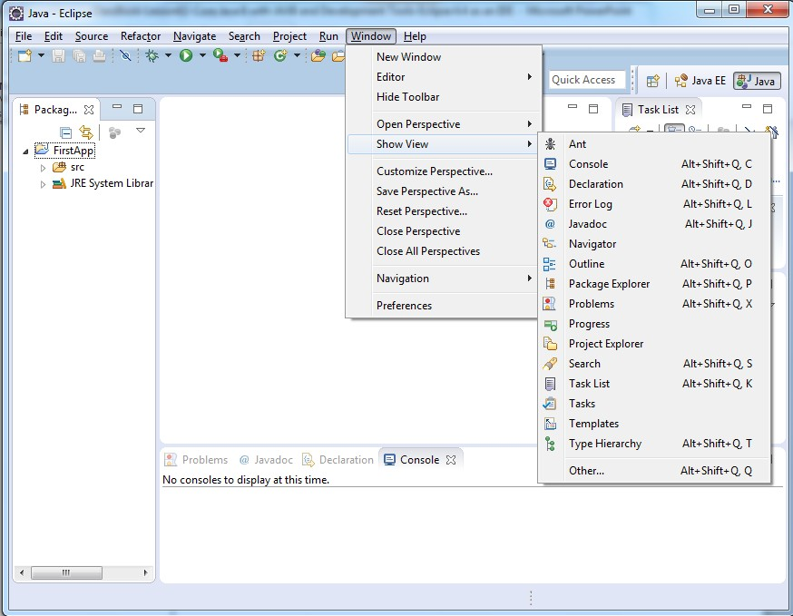
Core Java 8 and Development Tools
Eclipse 4.4 as an IDE
The Workbench:
View:
Views support editors and provide alternative presentations as well as ways to navigate the information in your Workbench.
For example: The Project Explorer and other navigation views display projects and
other resources that you are working with.
Perspectives offer pre-defined combinations of views and editors. To open a view that is not included in the current perspective, select Window → Show View from the main menu bar.
Page 02-8

Slide 9
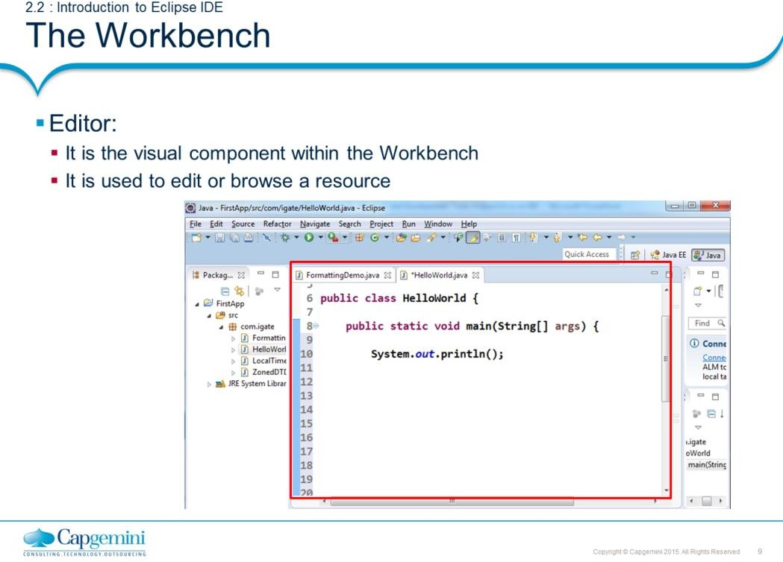
Core Java 8 and Development Tools
Eclipse 4.4 as an IDE
The Workbench:
Editor: Most perspectives in the Workbench comprise an editor area and one or more views. You can associate different editors with different types of files.
For example: When you open a file for editing by double-clicking it in one of the
navigation views, the associated editor opens in the Workbench.
If there is no associated editor for a resource, then the Workbench attempts to launch an external editor outside the Workbench.
For example: Suppose you have a .doc file in the Workbench, and Microsoft Word is registered as the editor for .doc files in your operating system. Then opening the file will launch Word as an OLE document within the Workbench editor area.
Page 02-9

Slide 10
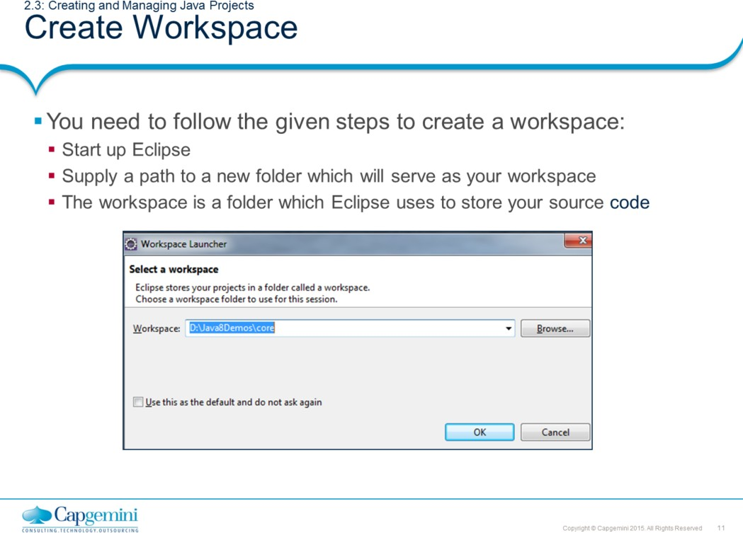
Core Java 8 and Development Tools
Eclipse 4.4 as an IDE

Slide 11
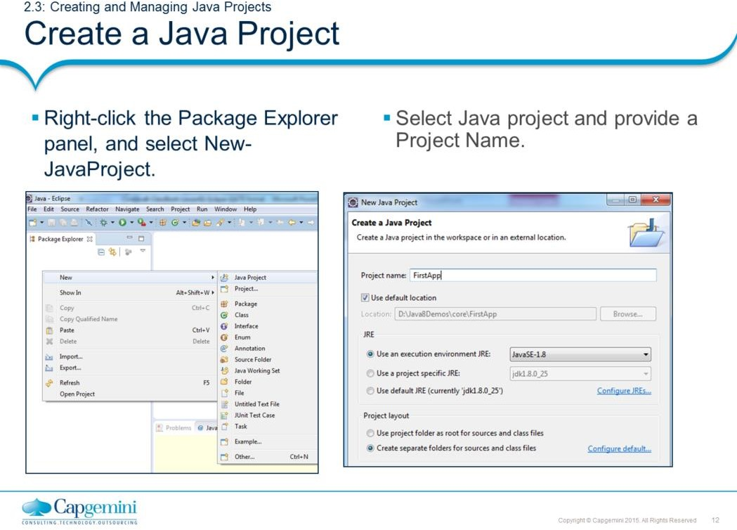
Core Java 8 and Development Tools
Eclipse 4.4 as an IDE
Creating and Managing Java Projects:
Create a Java Project:
When Eclipse starts, you will see the Welcome page. Close the Welcome page.
Right-click in the Package Explorer panel, and select New → JavaProject
and provide a Project name.
Note:
The name of the project is FirstApp. It is created in the workspace which you have selected in the beginning.
The Project uses jre1.8.0_25. The same folder will be used for storing both the source files and the class files.
The Java project can now include the following:
Class
Package
Interface
Source folder
Folder
File
Junit Test Case
Other - which may include other resources as text files

Slide 12
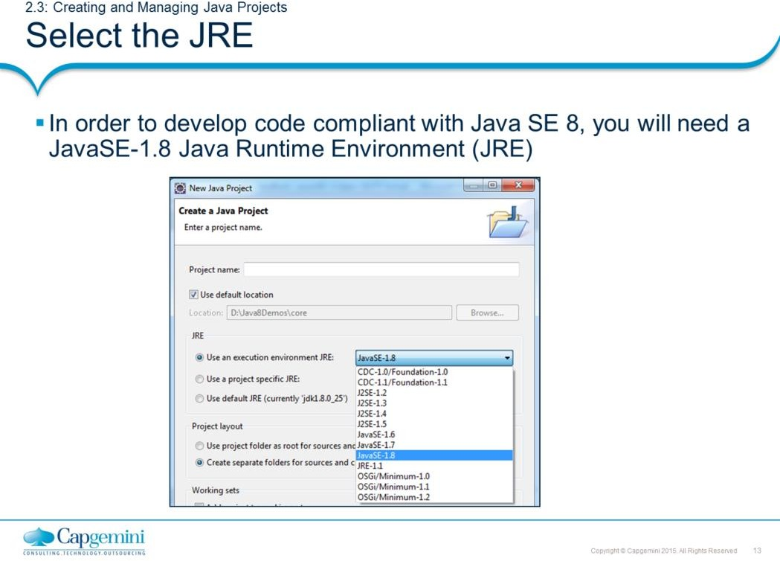
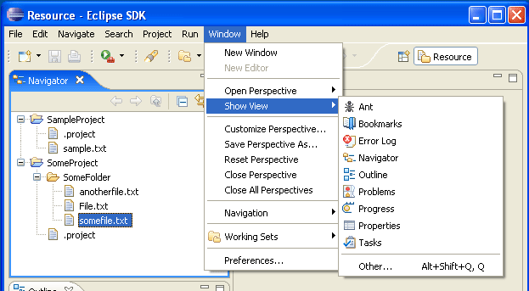
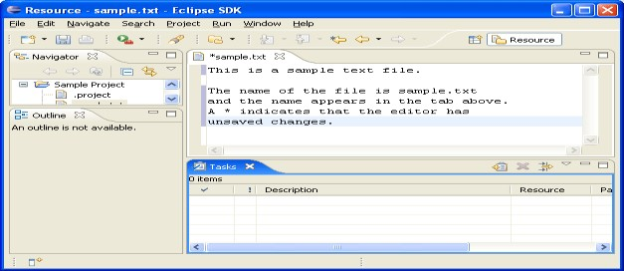
Core Java 8 and Development Tools
Eclipse 4.4 as an IDE
Creating and Managing Java Projects:
Select the JRE:
To use the new Java SE 1.8 features, you must be working on a project that has a 1.8 compliance level enabled and has a 1.8 JRE. New projects will automatically get 1.8-compliance while choosing a 1.8 JRE on the first page of the New Java Project wizard.
Depending on the type of file that is being edited, the appropriate editor is
displayed in the editor area.
For example: If a .TXT file is being edited, a text editor is displayed in the editor area.

Slide 13
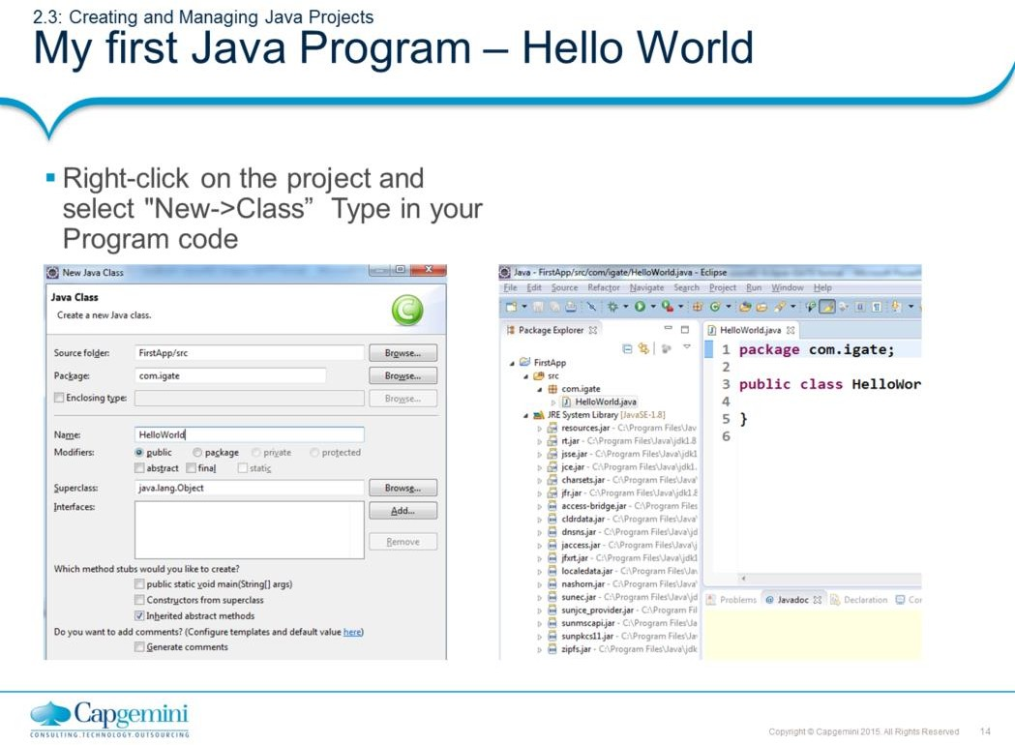
Core Java 8 and Development Tools
Eclipse 4.4 as an IDE
Creating and Managing Java Projects:
My first Java Program – Hello World:
If you want to create some new Java code, right-click the project and select “New → Class”.
In the dialog box created, give a name for the Java program in the Name
textbox.
Also notice that a package name is also given, as the usage of default package is discouraged. A package in Java is a group of classes which are often closely or logically related in some way. (The Package chapter is discussed later in the course).
Eclipse will generate skeleton of the class including default constructor.
Note:
The package name is com.igate.
The Java program’s name is HelloWorld.
The HelloWorld class will have the public access modifier.
The HelloWorld class inherits from java.lang.Object.
Developing the Java program will be easier as Eclipse editor will provide:
Syntax highlighting
Content/code assist
Code formatting
Import assistance
Quick fix

Slide 14
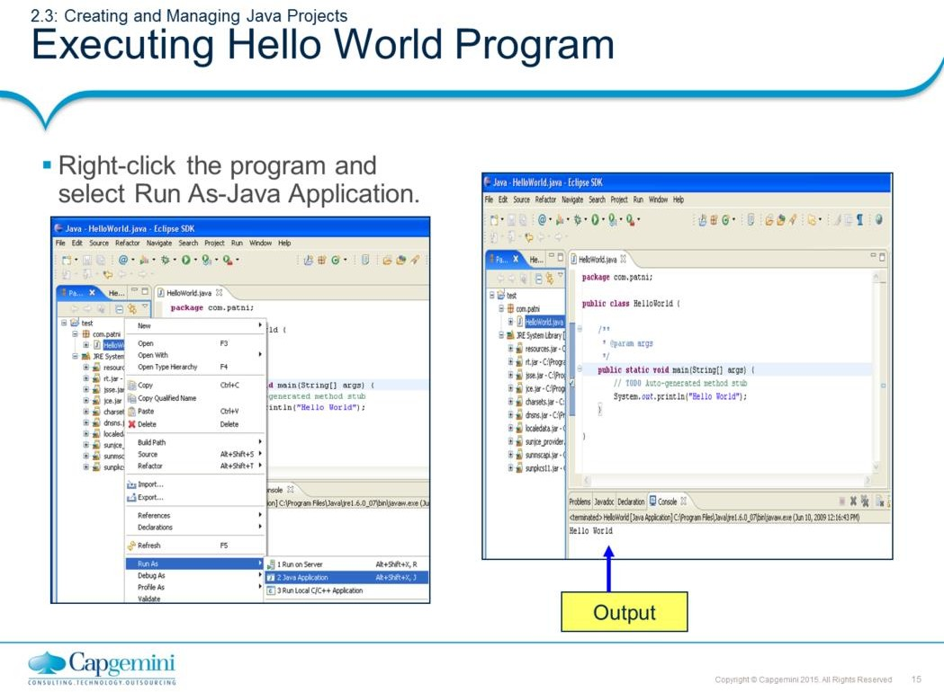
Core Java 8 and Development Tools
Eclipse 4.4 as an IDE
Creating and Managing Java Projects:
Executing Hello World Program:
Right-click the HelloWorld.java in the Package Explorer, and select
Run As → Java Application.
The program after execution produces the output in the Console view.
Running class from the Package Explorer as a Java Application uses the default settings for launching the selected class, and does not allow you to specify any arguments.

Slide 15
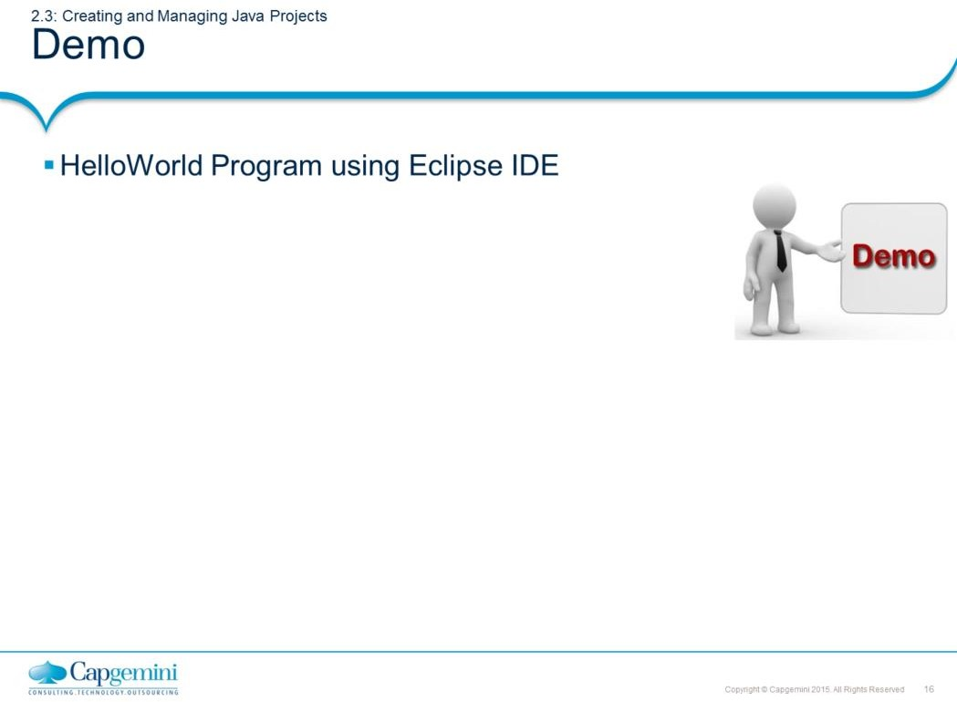
Core Java 8 and Development Tools
Eclipse 4.4 as an IDE

Slide 16
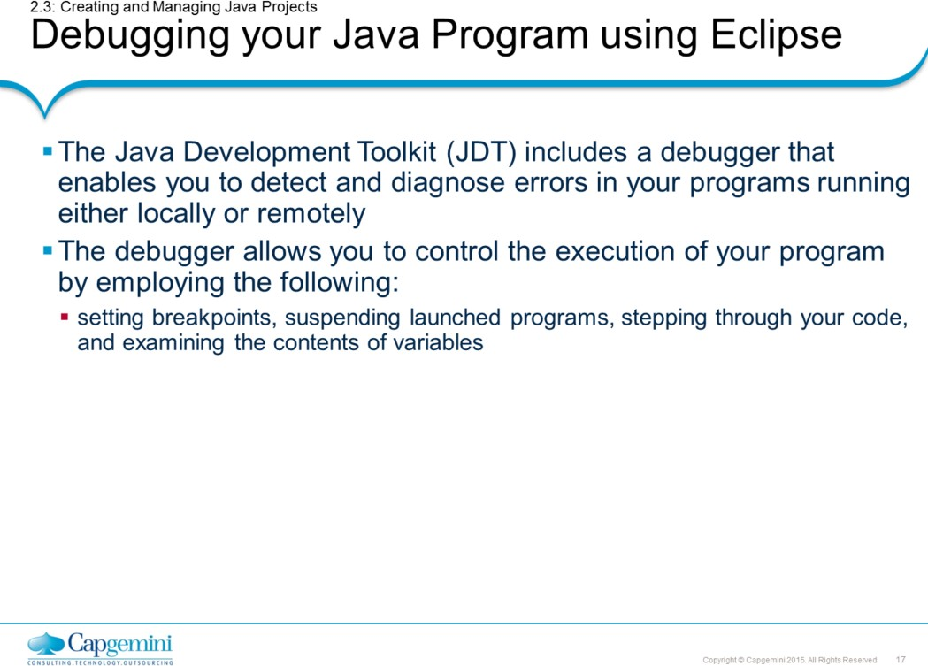
Core Java 8 and Development Tools
Eclipse 4.4 as an IDE

Slide 17
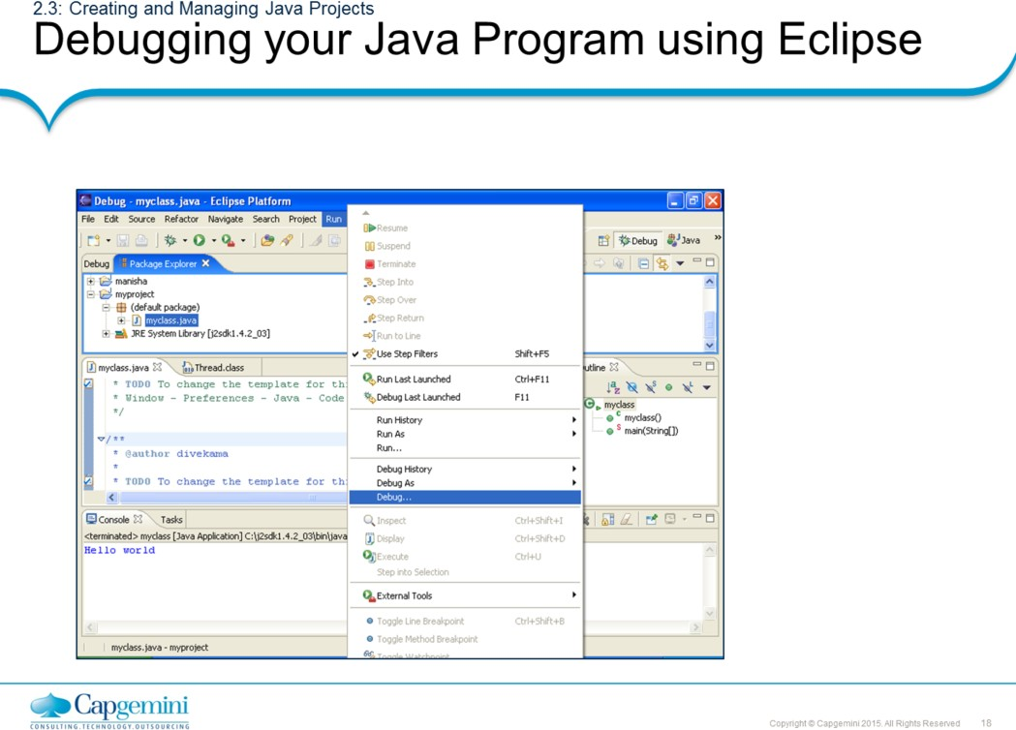
Core Java 8 and Development Tools
Eclipse 4.4 as an IDE
Creating and Managing Java Projects:
Debugging a Java Program:
Eclipse gives you auto-build facility, where recompilation of the necessary Java classes is done automatically.
To debug your Java program, select the Java source file which needs to be debugged, select Run → Debug. This will ask you to select an option to halt in public static void main() method, from where you may select to step into each and every function you come across or step over every function and only capture output of each function.

Slide 18
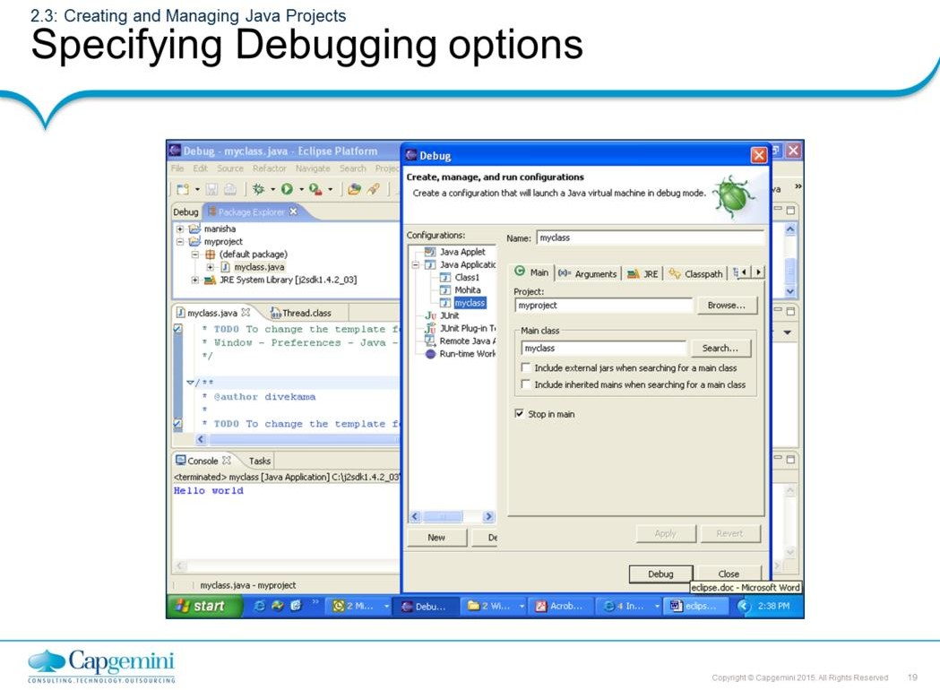
Core Java 8 and Development Tools
Eclipse 4.4 as an IDE
Note: Click Debug to start debugging process.

Slide 19
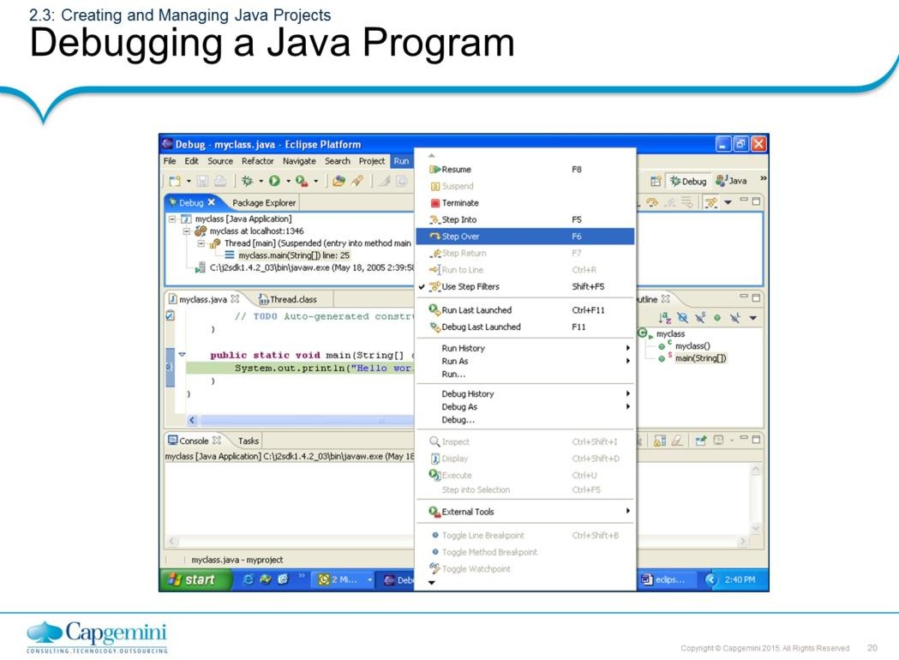
Core Java 8 and Development Tools
Eclipse 4.4 as an IDE
Creating and Managing Java Projects:
Debugging a Java Program:
Debugging can be attained by stepping-into or stepping-over the statements.
Step-into will traverse through each and every statement in a
function.
Step-over will generate output after the function call is over.
Tracing and watching the variable values is available as different debug views.

Slide 20
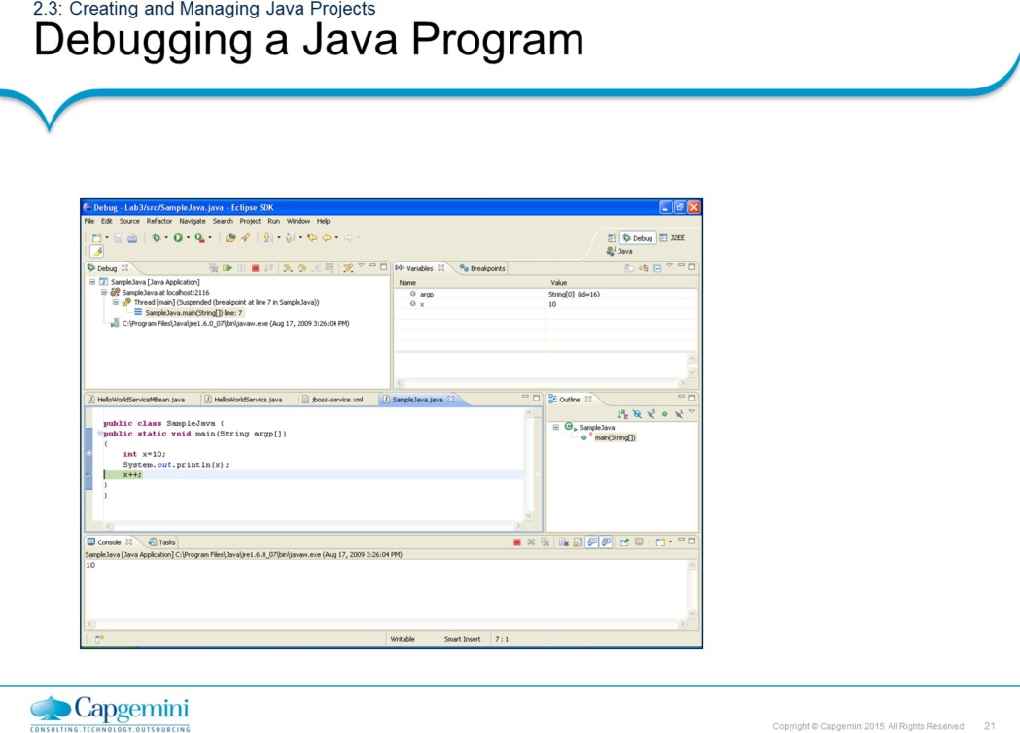
Core Java 8 and Development Tools
Eclipse 4.4 as an IDE
Creating and Managing Java Projects:
Debugging a Java Program:
You may launch your Java programs from the workbench. The programs may be launched in either run or debug mode.
In run mode, the program executes. However, the execution may not
be suspended or examined.
In debug mode, execution may be suspended and resumed, variables may be inspected, and expressions may be evaluated.
Variables view gives contents of the program variables at different statements in execution.
Breakpoints can be set for debugging, by opening the marker-bar pop-menu and selecting Toggle Breakpoint. While the Breakpoint is enabled, the thread execution suspends before the execution of the line happens. Breakpointing is a technique to set-up the starting point for program debugging.

Slide 21
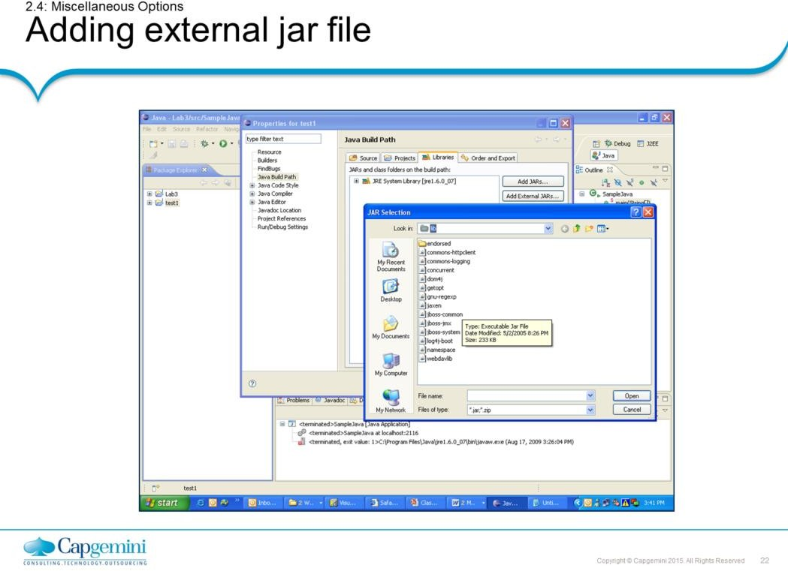
Core Java 8 and Development Tools
Eclipse 4.4 as an IDE
Miscellaneous Options:
Adding an external jar file:
When you are developing advanced Java programs, you might have to include some external jar files.
Click Project Properties.
Select Java build Path.
Click the Libraries tab, and click the Add External Jar Files button.
Locate the folder which contains the jar files, and click Open.

Slide 22
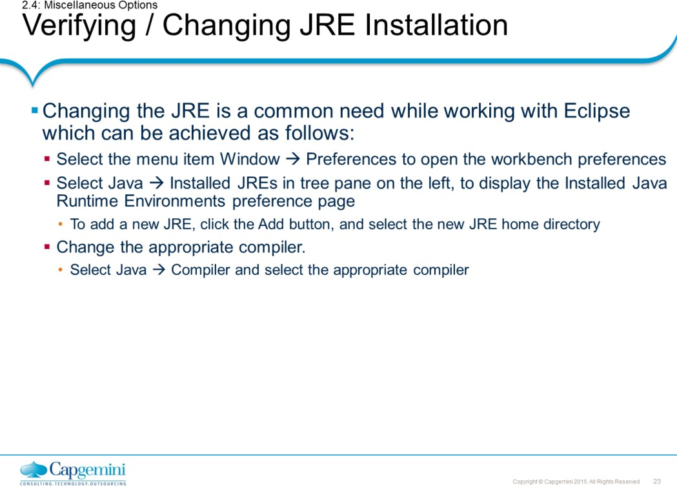
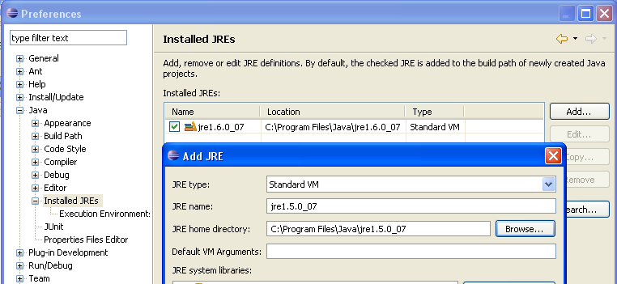
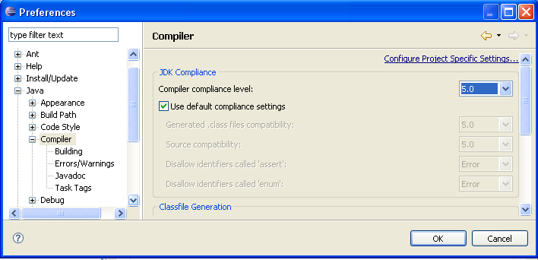
Core Java 8 and Development Tools
Eclipse 4.4 as an IDE

Slide 23
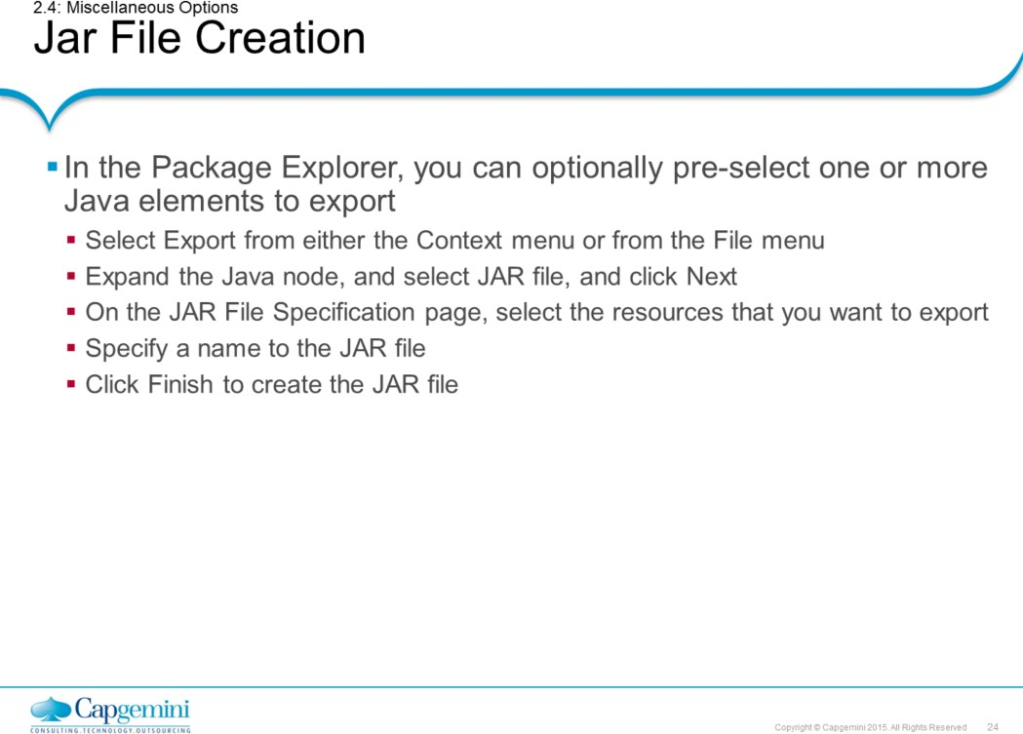
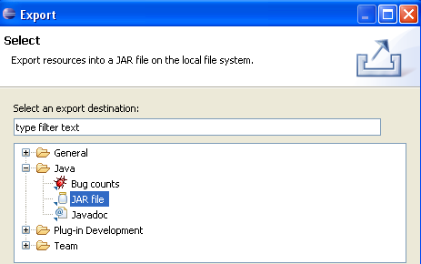
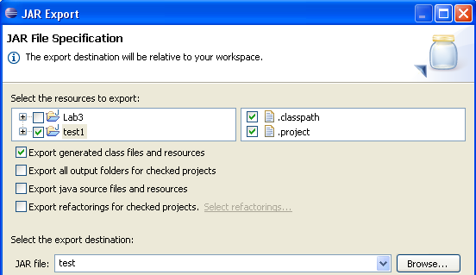
Core Java 8 and Development Tools
Eclipse 4.4 as an IDE

Slide 24
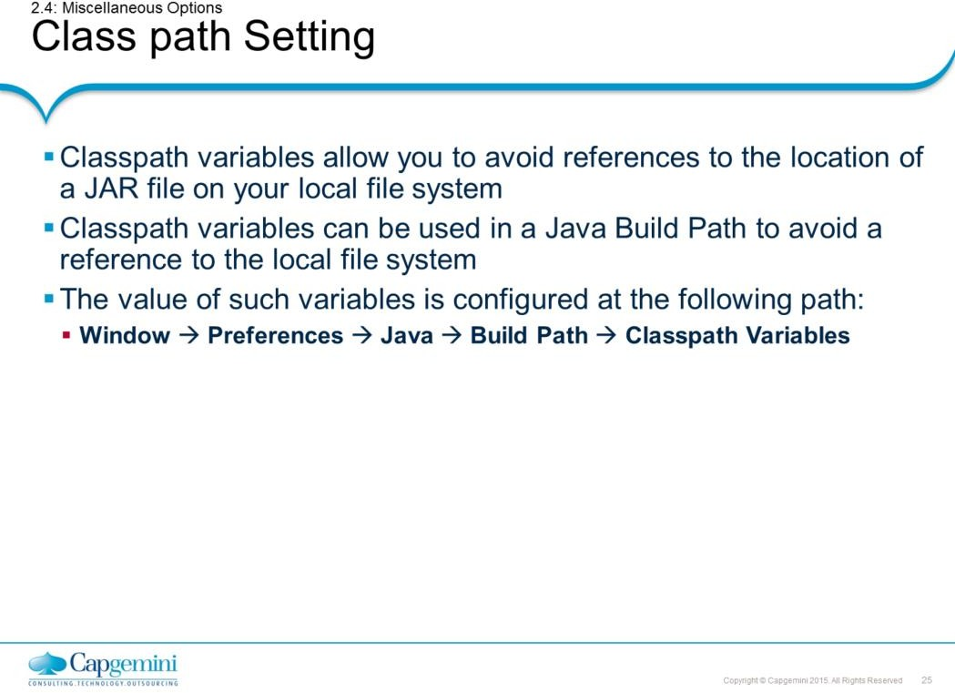
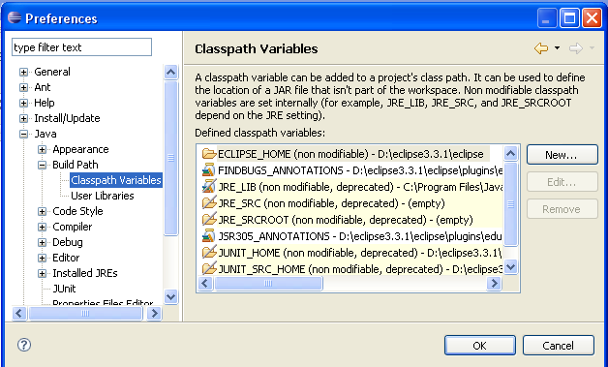
Core Java 8 and Development Tools
Eclipse 4.4 as an IDE
Miscellaneous Options: Setting Classpath:
Command
1. New...
Description
It adds a new variable entry. In the resulting dialog, specify
a
name and path for the new variable. You can click the File or Folder
buttons to browse for a path.
2. Edit...
It allows you to edit the selected variable entry. In the resulting dialog, edit the name and/or path for the variable. You can click the File or Folder buttons to browse for a path.
It removes the selected variable entry.
3. Remove…

Slide 25
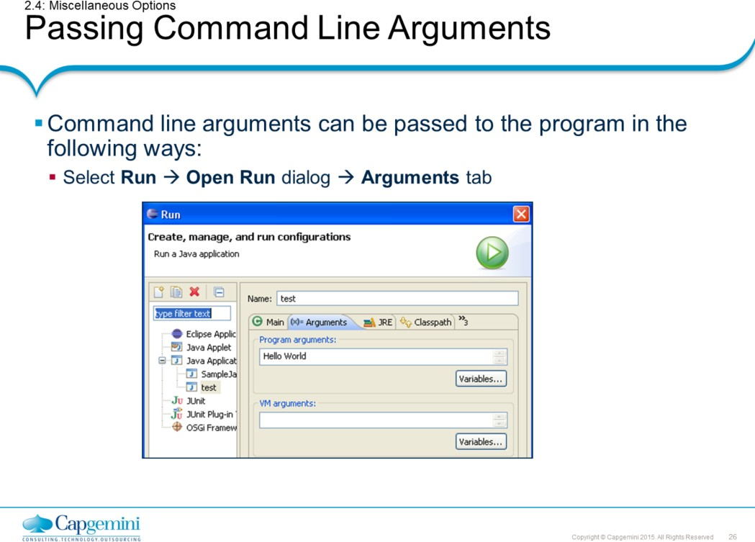
Core Java 8 and Development Tools
Eclipse 4.4 as an IDE
Note: In the snapshot shown in the above slide, there are two arguments “Hello” and “World”.

Slide 26
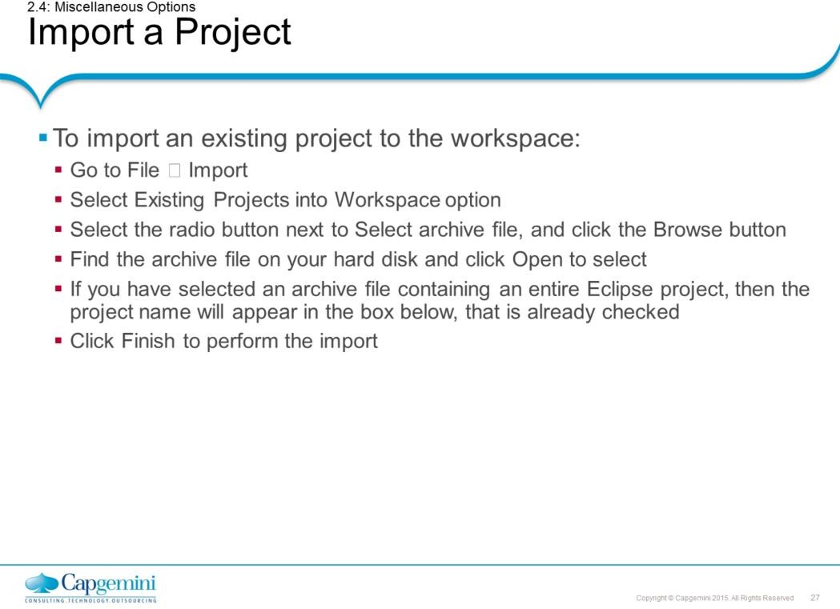
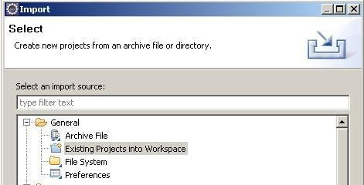
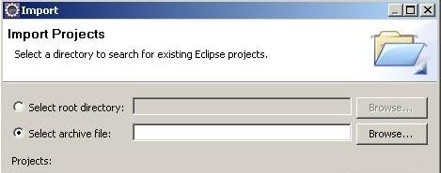
Core Java 8 and Development Tools
Eclipse 4.4 as an IDE
Import and Export Options:
Import a Project:
The snapshots of the above steps are given below:

Slide 27
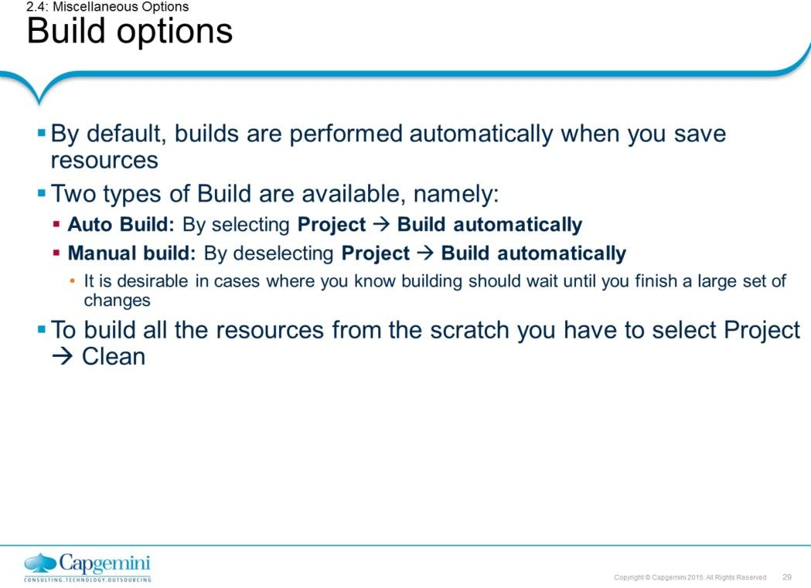
Core Java 8 and Development Tools
Eclipse 4.4 as an IDE
Builds:
Builders create or modify workspace resources, usually based on the existence and state of other resources. They are a powerful mechanism for enforcing the constraints of some domain.
For example: A Java builder converts Java source files (.java files) into executable class files (.class files), a web link builder updates links to files whose name/location have changed, and so on.
As resources are created and modified, builders are run and the constraints are maintained. This transform need not be one to one.
For example: A single .java file can produce several .class files.
Page 02-29

Slide 28
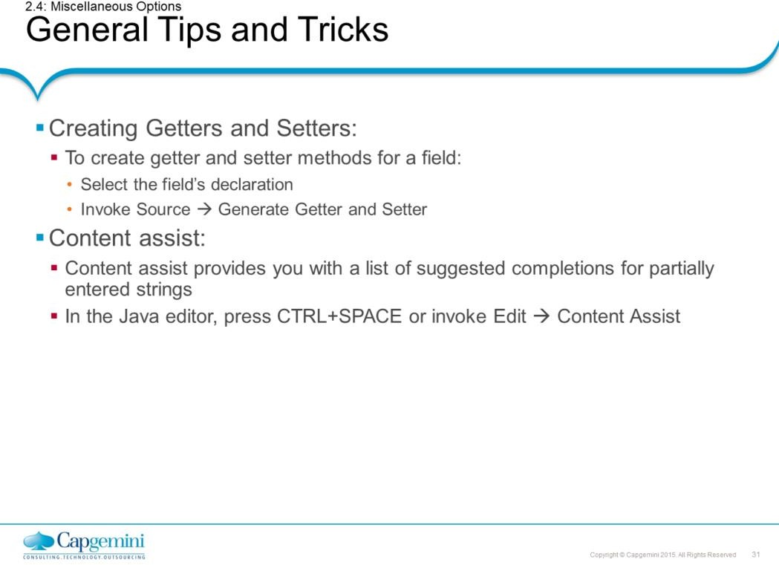
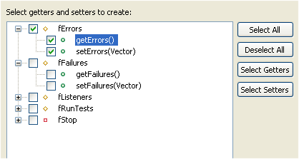
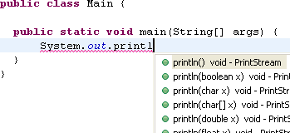
Core Java 8 and Development Tools
Eclipse 4.4 as an IDE
Miscellaneous Options:
Tips and Tricks:
Creating getters and Setters :
Select the field’s declaration, and invoke Source → Generate Getter and Setter.

Slide 29
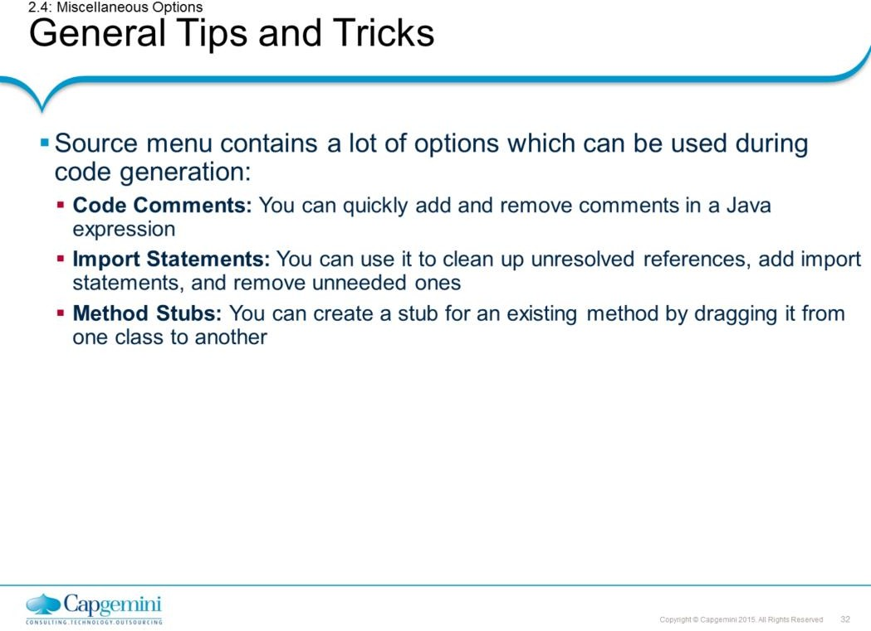
Core Java 8 and Development Tools
Eclipse 4.4 as an IDE

Slide 30
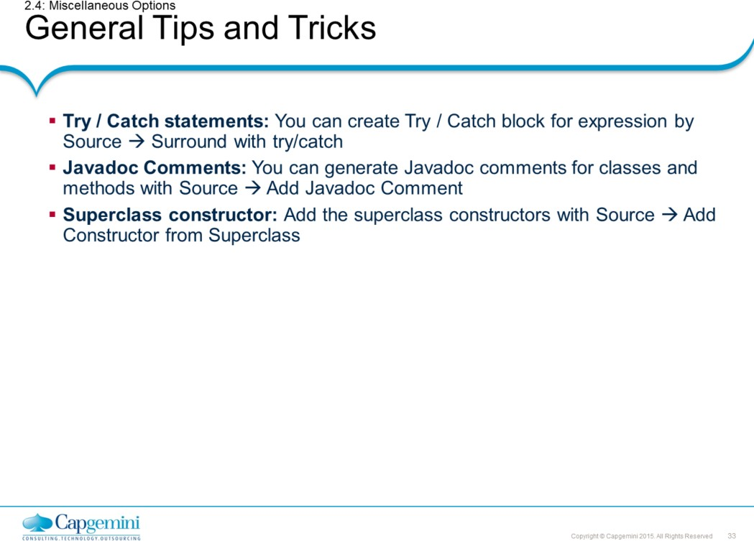
Core Java 8 and Development Tools
Eclipse 4.4 as an IDE

Slide 31
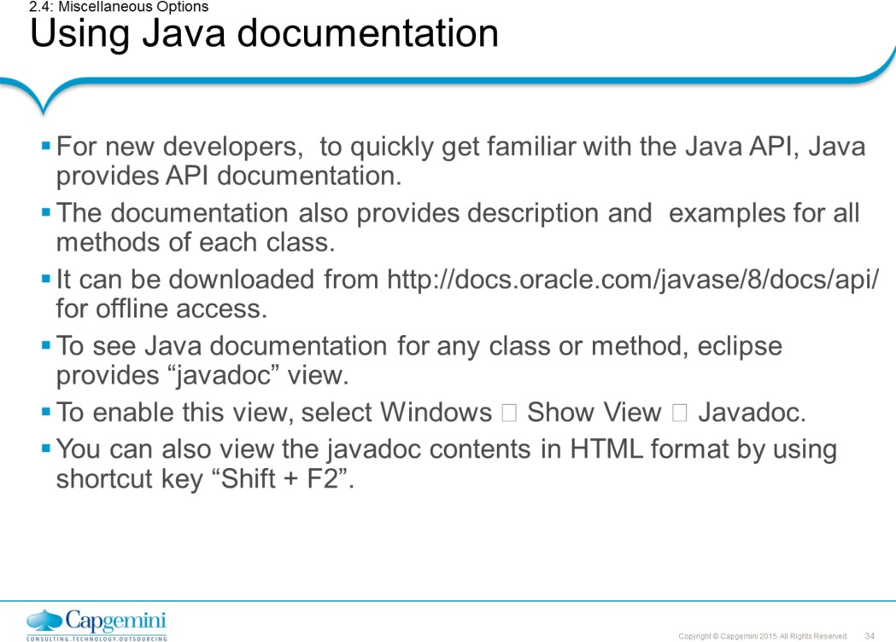
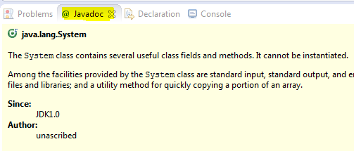
Core Java 8 and Development Tools
Eclipse 4.4 as an IDE
Using Java documentation:
Java API provides documentation which is good resource to get familiar with it. This documentation is valuable resource for programmers wishing to construct the applications in Java.
The documentation provides all information about the Java API. It includes list of classes or objects available to programmer.
Javadoc View:
Eclipse provides the javadoc view which shows the available documentation for selected class or method. To enable this view, select Windows → Show View → Javadoc.

Slide 32
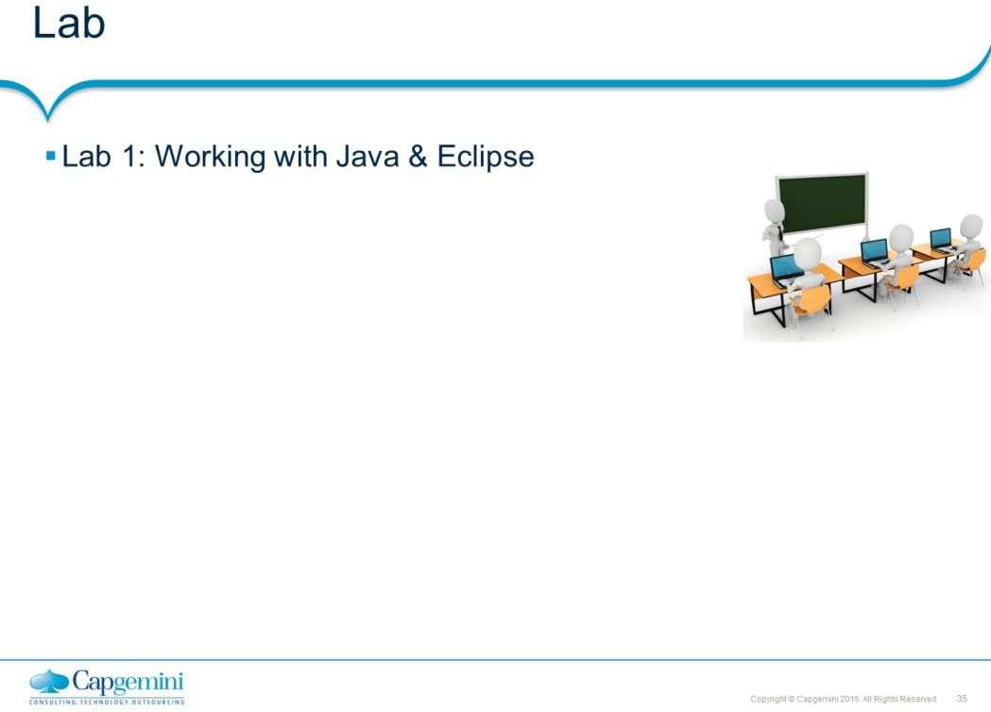
Core Java 8 and Development Tools
Eclipse 4.4 as an IDE

Slide 33
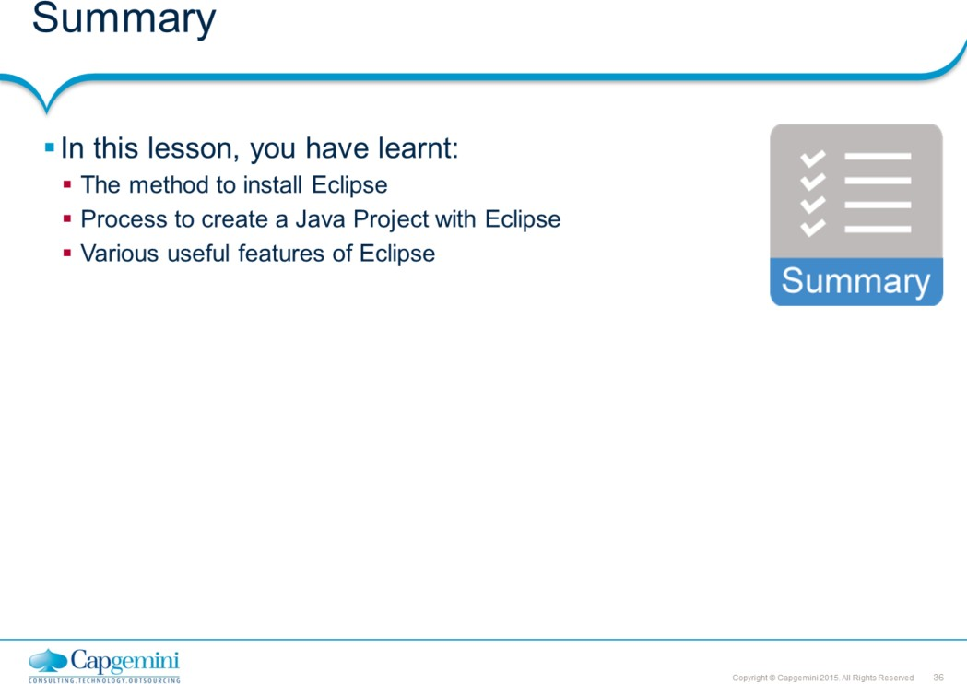
Core Java 8 and Development Tools
Eclipse 4.4 as an IDE

Slide 34
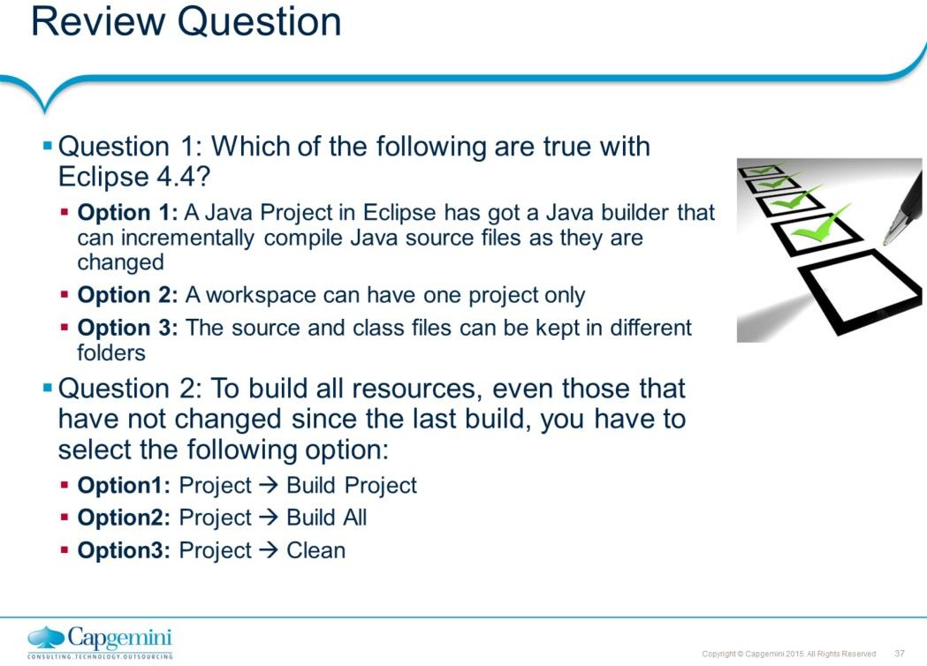
Core Java 8 and Development Tools
Eclipse 4.4 as an IDE
Add the notes here.

